Slide 1
The Stick champ
A game built with BGI C library

Slide 2
The Stick Champ
Submitted To:
Dr Md Asif Hossain Khan
Associate Proffesor
Ms. Anna Fariha
Lecturer
Submitted By:
Mehreen Rahman Rebab
SN- 61
Department of Computer Science & Engineering
University of Dhaka

Slide 3
Introduction
The main objective of this project is to implement a basic graphics library named BGI (Borland Graphics Interface) built in C.
BGI is a graphics library bundled with several Borland compilers for the DOS operating systems since 1987.
BGI is less powerful than modern graphics libraries such as OpenGL since it was designed for presentation graphics rather than supporting 3D environment, making it simpler to code and implement.

Slide 4
Project outline
A 2D continuous game
Inspired by a very popular game named Stick Hero
Keyboard navigation by the user
A single player game
The objective of the user is to estimate the distance between the consecutive pillars
User has to judge the distance & make a jump

Slide 5
Main menu features
There’s a main menu implemented for the user’s convenience
User can navigate through options
Mouse input implementation
When the user puts a mouse click on the “Play Now” tab, the main game will start right away

Slide 6
Main menu features
There are two tabs for Credits & Exit game
By clicking on the “Exit Game”, user can directly finish the game & exit out
All the tabs have indicators to highlight which one is selected detecting mouse click

Slide 7
How to play
A tab named “How To Play” is added to the main menu
By clicking on this tab, user gets to know how to play the game
Shows the keyboard keys & navigation needed to play the game
Ensured the user’s gaming experience & convenience

Slide 8
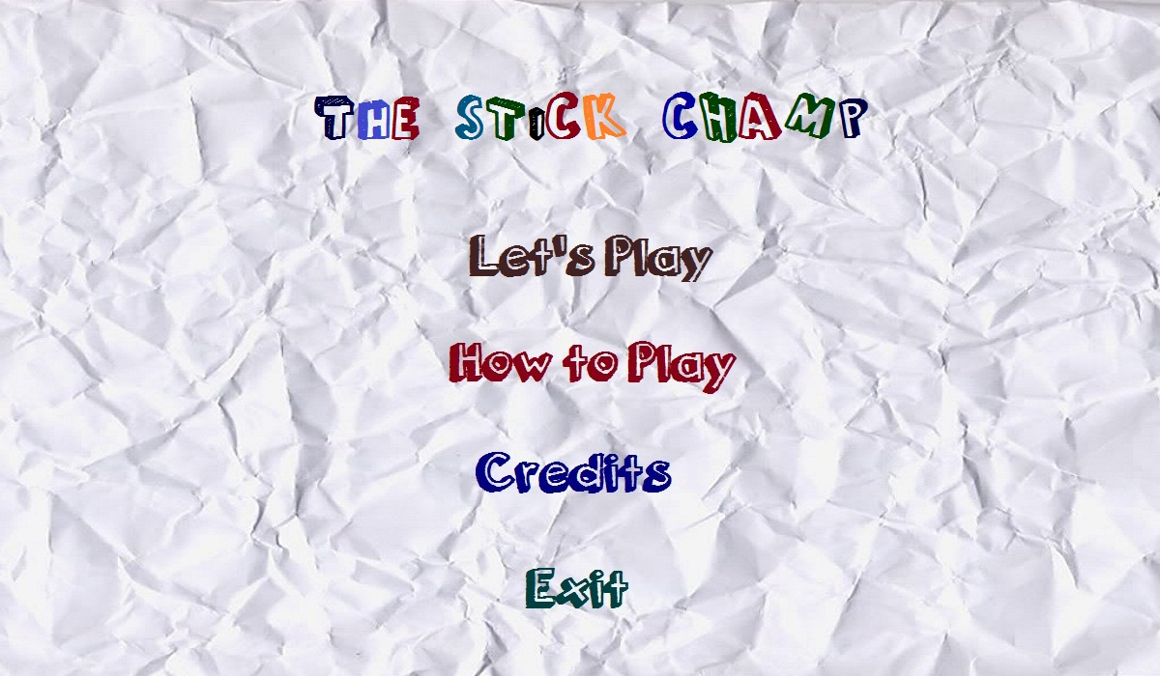
Main menu interface

Slide 9
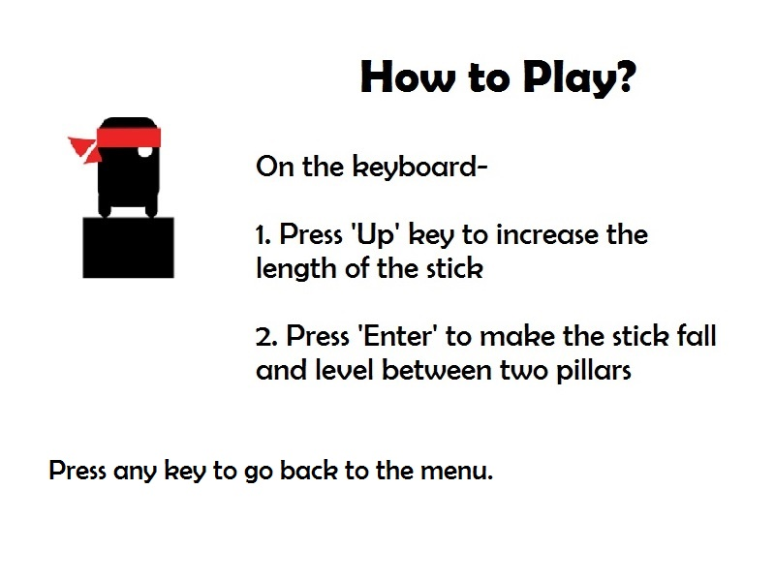
How to play

Slide 10
Features
In the game, there’s a character named Ninja who’s escaping using his stick
There will be pillars appearing with different distances
The Ninja can form and increment the stick
Then the stick will fall down and thus the ninja will cross the distance between two consecutive pillars by walking on his stick.

Slide 11
Features
The increment of the stick depends on the user
More the user presses the up key, the longer the stick grows
If the user fails to judge the distance correctly, the game ends as the ninja fails to reach to the next pillar & thus it falls between the blank space
Every successful reach earns a point

Slide 12
Coding implementation
At first, the whole coding was divided into modules.
The main menu containing main game play, How to play, Credits and Exit each having different modules and .cpp files
The first phase was the character designing. The Ninja was drawn using polygons and ellipses, all parts drawn by different functions & passing variable.

Slide 13
Coding implementation
The perfect measurement according to the window has been accomplished after several testing
For the keyboard navigation, the ASCII characters for up arrow key, enter & escape has been used
In the main game play, all the events such as stick increment, taking input, stick falling are done in different functions

Slide 14
Defined functions
Header file: MyHeader.h
void dellipse()
void dpoly()
Void linesinc()
void printmenu()
Void printscore()
void game()
void printhowtoplay()
void credits()
void gameover()

Slide 15
Algorithm layout
Main
Print Menu
Game Load
Credits
Play Now
How To Play
Exit

Slide 16
Algorithm layout
Play Now
Background load
Game()
Ninja move succeed
Stick grow
Stick falling as bridge
Move failed
Random Thick Pillar print
Wait for keyboard input
Game over

Slide 17
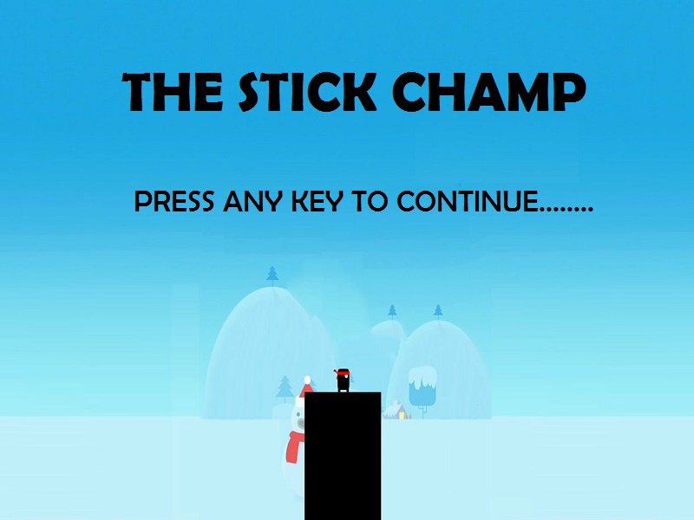
Game Loading

Slide 18
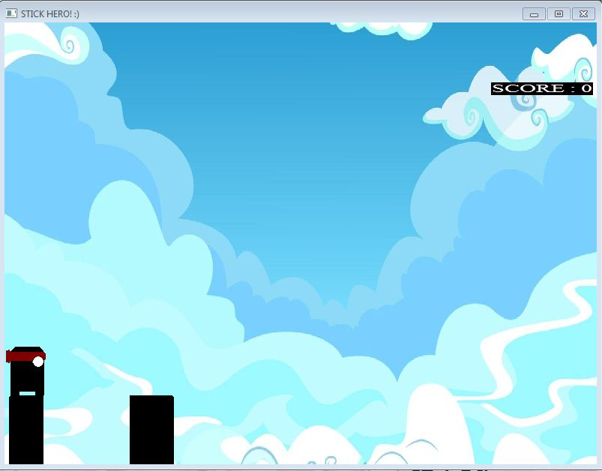
Game interface

Slide 19
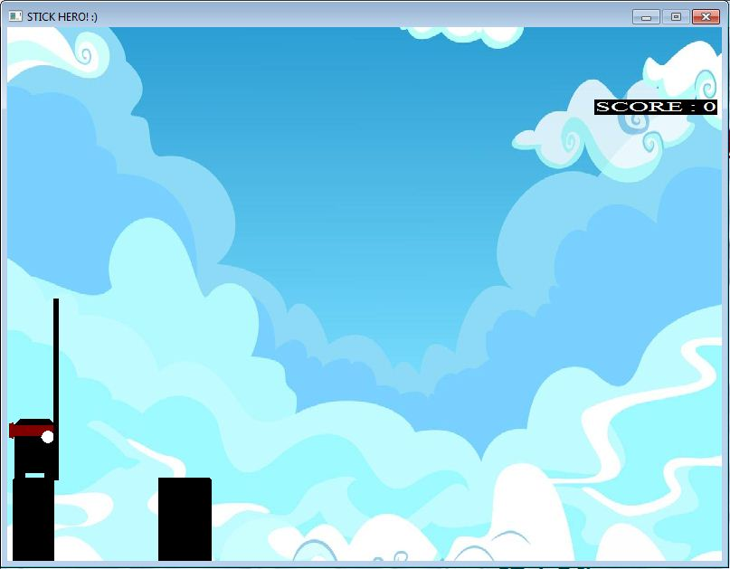
Game interface

Slide 20
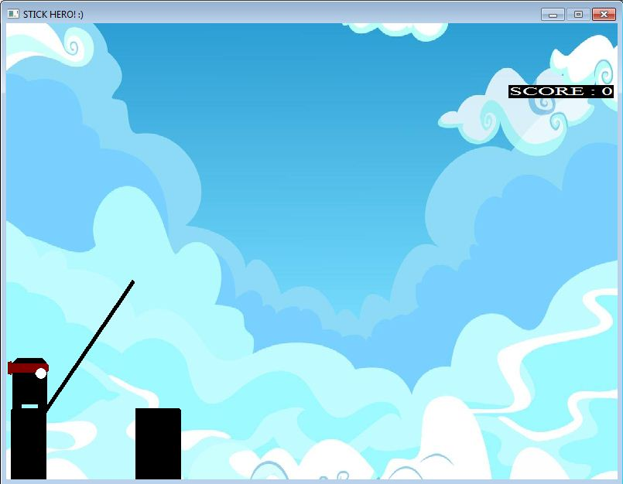
Game interface

Slide 21
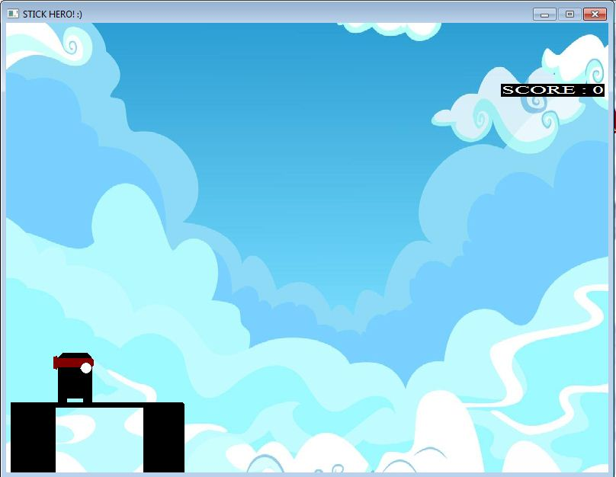
Game interface

Slide 22
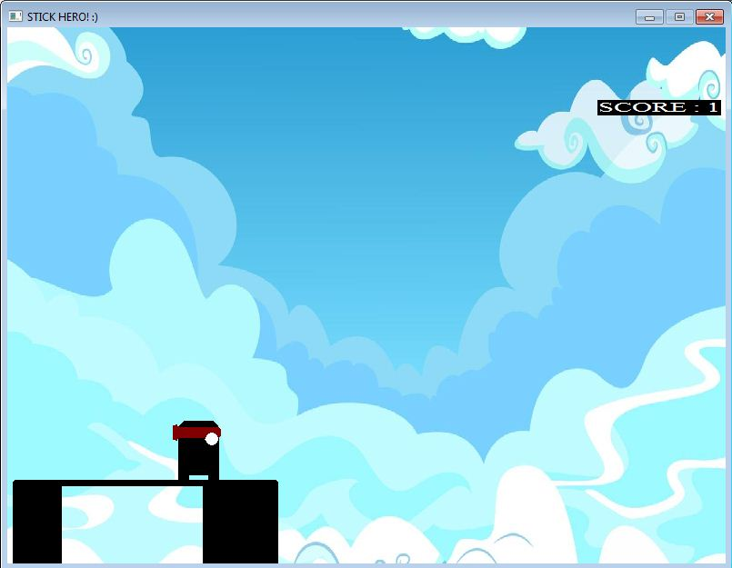
Game interface

Slide 23
Challenges faced
Using delay function can reduce flickering when there’s a background continuously loading in the game
But using too much delay beyond a certain limit slows down the game play
So there is no other option in BGI other than refreshing the screen with the background image repeatedly

Slide 24
Challenges faced
The amount of each delay time as well as the repetition of refreshing screen with the background image had to be tested too many times just to ensure the players’ satisfaction
This testing & compiling phase was tough and certainly a time consuming task

Slide 25
References
C The Complete Reference (4th Edition) By Herbert Schildt
Programming in ANSI C By E.Balaguruswami
http://www.cs.colorado.edu
http://www.programmingsimplified.com
http://www.mycplus.com/tutorials/c-programming-tutorials/graphics-programming
http://cprogrammingexpert.com/C/Tutorial/graphics.aspx
http://en.wikipedia.org/

Slide 26
Words of gratitude
Due to such a short time in such a busy schedule,
It needed tremendous hard work to complete the game. However, it was fun to actually make something from scratch & implement a graphics library for animation & a wide range of tasks with C language for the first time.
Heartiest gratitude to the respected teachers and classmates who helped a lot to make this project.

Slide 27
THANK YOU

